Slide 1
EZ MESSENGER CUSTOMER portal training
For
the Office of the Attorney General of Texas

Slide 2
WELCOME
Welcome to the EZ Messenger Service of Process Webinar, please note the following items:
We need your assistance in providing your name and office for our attendance log. The host will take attendance at the beginning of the webinar. If you have a name that may be difficult to spell feel free to use the Join.Me chat feature to send a message to the host.
During the webinar please do not place your phone on hold. Placing on hold may cause hold music to play and interfere with the webinar.
Use *6 to mute your phone during periods that you don’t need to speak. This will help reduce background noise. Use *6 to unmute your line if you have a question or comment.
Please note the EZ Messenger customer portal is not a replacement to the OAG portal for service requests. You will continue entering service requests on the OAG service portal. The only difference in workflow will be the upload of documents to the EZ Messenger customer portal instead of encrypted email.
Where possible please hold questions and comments to the end of the presentation.

Slide 3
LOGIN
Then type your Username and Password and select ‘LOGIN’ to be directed to our ‘Welcome’ screen.
To log in go to www.ezmessenger.com and select ‘LOGIN’ at the upper right corner.

Slide 4
User id’s
Your User ID will match your mainframe User ID. Upon creation of your User ID by the account administrator you should receive an email prompting you to log in and create your own password. Passwords will follow OAG rules. Emails will be delivered with your password around December 18th.

Slide 5
LOGIN TYPES
The Texas Office of the Attorney General account logins are divided into different types. Each login name and password grants a particular type of access.
The Field Office staff logins will present all jobs that need a document upload specific to the Field Office staff that is logging in. The Field Office staff will be able to review all jobs pertaining to their office in all other categories.
Regional logins will provide more information and will display all cases in the system from all of the offices and staff members within that particular region.
Based on your login type you will notice differences in viewing options. This will particularly be noticeable in the Document Center, Jobs In Field, Check Status and Performance areas of the website.

Slide 6
Welcome screen
Notifications
Login Name
Navigation
Links
Job Search
Welcome Message and EZ Messenger Contact Information
Launch F.A.S.T. Bulletin
Document Center

Slide 7
DOCUMENT CENTER
The Document Center is a listing of submitted jobs that need documents attached for service, delivery or filing. You can also view uploaded documents.

Slide 8
Attach documents to the job by clicking the Upload Documents link then you can select items, insert to the ‘Upload Documents’ window and select ‘Upload Files’ to attach them to the job.

Slide 9
CHECK STATUS
You can either use the bubble in the upper right corner of the screen to find jobs you want to check status on or you can use our ‘Check Status’ feature.
When using the Check Status feature you can search for specific items based on multiple specific criteria. The Check Status is often a more responsive, quicker option.

Slide 10
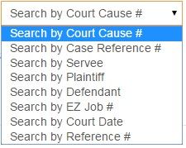
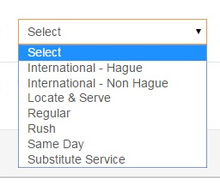
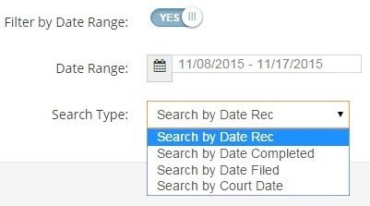
Search options
Search Query
Job Types
Date Range

Slide 11
Search results/ job details
Search results will net a listing of related jobs with a snapshot of details such as Servee, Active Address and Status. It will also provide quick links to Status, Documents, Affidavits and Photos. You can select to exclude columns if you like and even download the information into a .CSV file.

Slide 12
Job summary
When you select a job by clicking the servee name you are taken to the ‘Job Summary’ screen. This screen will provide you access to detailed information for the job including:
Job Info
Status
Scans
Photos
Addresses
Linked Jobs
Timeline

Slide 13
Job info
Case Info
Court cause number
Filing information
Case caption
Job Info
Attorney and Staff on case
Case Reference Number
Active Address
Job type
Documents
Court date
Server
Service details
Quick Links to:
Insert status note
View Workorder
Print affidavit
Job scoring
Forms
Name of servee

Slide 14
status
You can view various forms of status with dates and times. Statuses can be sorted and filtered in various manners. This data can also be downloaded to a .CSV file.
Send notes to EZ Messenger staff using the ‘Insert Status Note’ link. The ‘High Priority’ button should be selected for any items requiring rush attention. New address and cancel requests should be sent thru the OAG system instead of thru this feature.

Slide 15
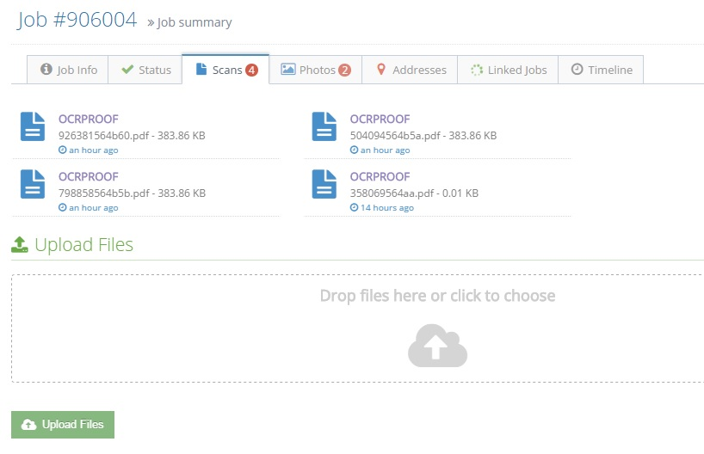
SCANS
Any scans currently attached to the job can be viewed here. You can also upload additional scans as needed.

Slide 16
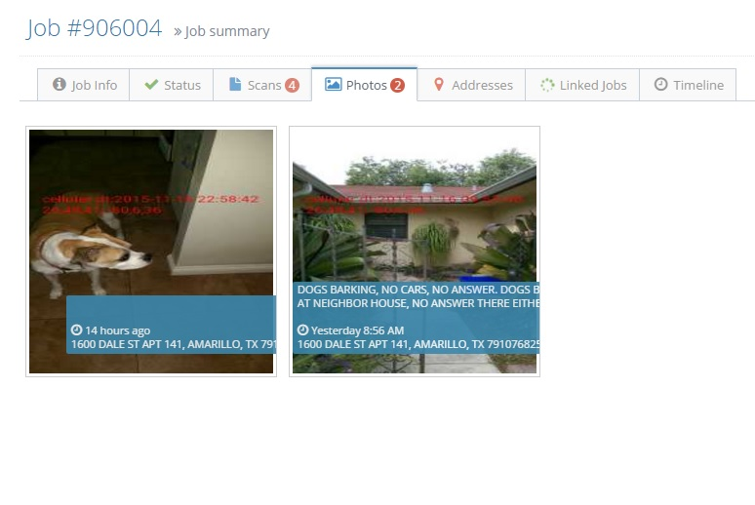
PHOTOS
View photos associated with attempts and service completions.
Photos are geo-tagged and have the status note, date, time and address of attempt.
Photos are of the location attempted, not the person(s).

Slide 17
timeline
The Timeline shows a chronological listing of events on the selected job.

Slide 18
Welcome screen
Notifications
Login Name
Navigation
Links
Job Search
Welcome Message and EZ Messenger Contact Information
Launch F.A.S.T. Bulletin
Document Center

Slide 19
WELCOME SCREEN INFORMATION
Login
Displays the name you are currently logged in under.
Access to the ‘Logout’ option.
Access to ‘Account’ where you can view and edit your account information.
Important message notifications from EZ Messenger.
Name and contact information for the EZ Messenger management staff.
Welcome Message and EZ Messenger Contact Information
Navigation Links
Home – returns you to the Welcome screen.
Jobs in Field – takes you to a map with pins representing active jobs out in the field.
Check Status – search for jobs in a variety of ways.
Document Center – access jobs in order to attach documents.
Performance – view the performance metrics regarding your jobs.
Launch F.A.S.T Bulletin
Relaunch the Bulletin to review any special announcements posted by EZ Messenger.
Notifications
Alerts you to additional notifications which may have occurred since your last login.
Document Center
Listing of cases which still need documents to be attached in order to be sent for service, filing or delivery.
Job Search
Log-in level search for any criteria. Displays open and closed job searches.

Slide 20
Notifications
The quick link on the Welcome screen will display a snapshot of any new notifications since your last login. You can select to view items by clicking on the appropriate link or by selecting ‘See all notifications’ at the bottom which will take you to your ‘Activity Feed’.

Slide 21
Jobs in field
You can use the ‘Jobs in Field’ link to see a map with pins for where open jobs are taking place. You can also select ‘Map’ or ‘Satellite’ views in the upper right corner of the map.
Click on a pin to open up a description of the Job Number, Servee, Address as well as quick links to get to the Job Summary screen, Print Workorder and View status items.
Areas with a large circle and a number in the center are locations where there are multiple jobs in the nearby area. Scroll in on the map or click the number to zoom in to get a view of individual pins.

Slide 22
performance
Performance Metrics snapshot for your account can be seen here.
Details in regards to each type of metric can be accessed by clicking the blue ‘Details’ link.

Slide 23
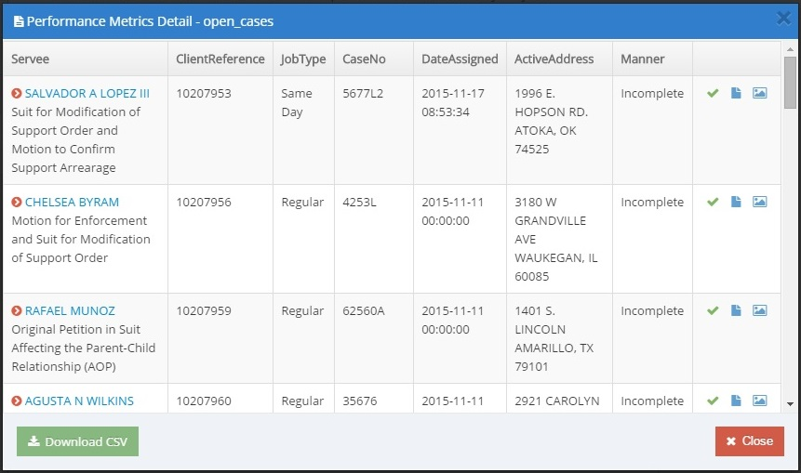
Performance metrics detail
After you select ‘Details’ you will see a listing of the total items that make up the section in question.
You can view job details, status, attached scans and photos. You can also download a .CSV file to open in Excel.

Slide 24
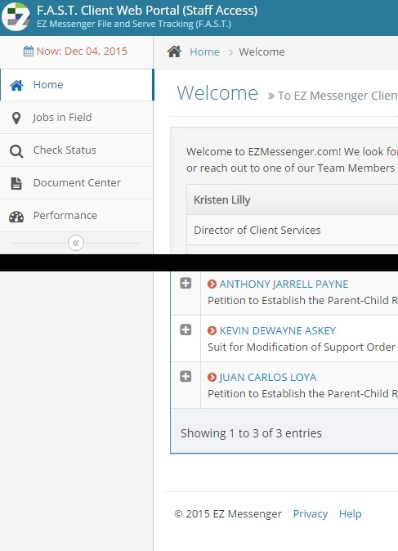
help
Don’t quite remember where to find something? There is a ‘Help’ link at the bottom of the Welcome screen. This will take the user to a copy of this web presentation.
Still can’t quite find what you are looking for? Call us at (844) 315-6931and a member of our staff will be happy to assist you.

Slide 25
EMAIL ConTACT
Individual email addresses exist for each OAG Region, those email addresses will deliver directly to the EZ Messenger Client Executive assigned to your region. Those email addresses are:
Region 1 = txoag1@ezmessenger.com
Region 2 = txoag2@ezmessenger.com
Region 3 = txoag3@ezmessenger.com
Region 4 = txoag4@ezmessenger.com
Region 5 = txoag5@ezmessenger.com
Region 6 = txoag6@ezmessenger.com
Region 7 = txoag7@ezmessenger.com
Region 8 = txoag8@ezmessenger.com
Region 9 = txoag9@ezmessenger.com
Please email your respective mail box with your list of attendees to this presentation immediately following the close of the presentation. THANK YOU!

